Slide 1
Which entropy estimator to use?

Slide 2
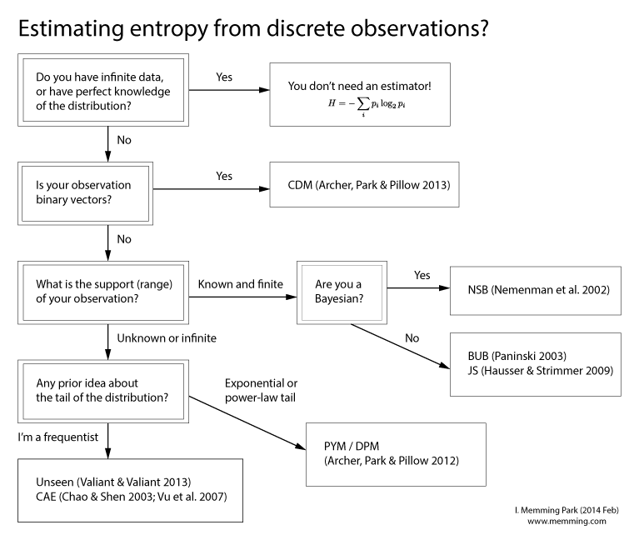

Slide 3
Estimating entropy from continuous observations?
Is Data/Dimensionality large?
Yes
Equiprobable histogram
No
Are your measurements very precise?
Yes
Nearest-neighbor
entropy estimators
(Kozachenko and Leonenko (1987)
No
k^{th}-Nearest-neighbors
entropy estimators
Singh et al. (2003)

Slide 4
Mutual information estimators
Simplest is to use the previous entropy estimators with
but in the case of large or small entropies this can result in overflow/underflow, respectively.

